Slide 1
Save Money with VoIP!
Scott Fox
Director of Technology Services
Palos School District 118
Eric Nush
Network/System Administrator
Palos School District 118

Slide 2
About Us
Palos School District 118 in Palos Park, IL
~45 Min South of Chicago
PreK-8, 2,500 Students
Two Elementary Schools (PreK-5), One Middle School (6-8)
Admin Building, Transportation/Operations Building
Windows School District, 1:1 in our Middle School
Most Servers and Services On Site
Fiber WAN to all buildings, Fiber ISP from WOW

Slide 3
Previous System- 2016
3COM/Vertical system
Digital phones over analog lines, lots of interference (hums/hiss/AM Radio)
2 PRI Lines, main/failover
40 POTS line (security system, elevators, fax, gas meter, etc)
System was End Of Life, support expensive
Only one company in the area could service it
No user-serviceable parts
Database corruption, boards failing
Only backup was a floppy disk
Voicemail very limited, ran on Windows 98 Computer
No mobile apps

Slide 4
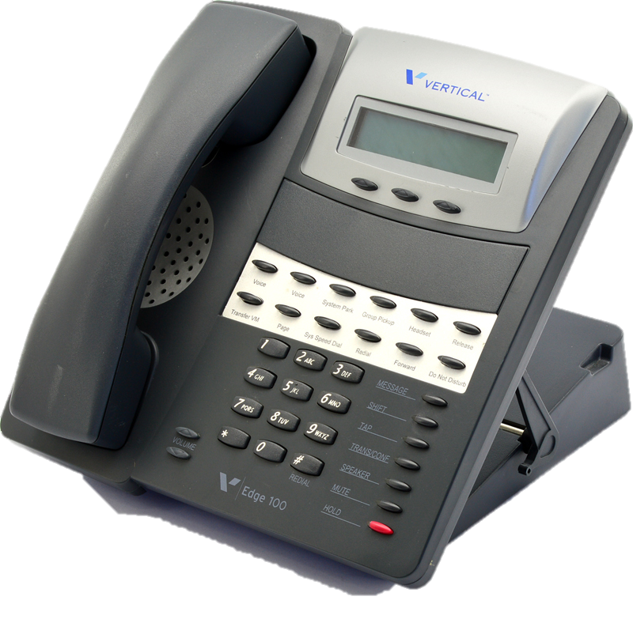

Slide 5
Previous System- 2016
Annual Costs
PBX Service - $5,000
PRI Circuits - $18,000
POTS - $19,200 (and increasing)
Total: $42,200/year
New Addition Hardware - $14,500

Slide 6
Benefits of VoIP
Call Clarity (in district crystal clear HD Audio)
Call Clarity (external calls depend on contact method, SIP > SIP is still HD)
Every call digital, no hums/hiss or AM Radio
Easy to manage web interface, we can do updates ourselves
Phone with LCD Screens, digital labels (no more handwritten labels)
Phone directory on each phone
Speed Dial Buttons
Smart Phone Apps
Failover (Hyper-V Clusters/Replication)
Hold Music
SIP-complaint, any SIP device can be used
Cost Savings!

Slide 7
E911
Know your area’s rules for E911
Illinois/Chicago Area – Business
Cannot require extra digits to dial 911 (no 9 for outside line, then 911)
1 - E911 Number per 40,000 sq ft, or each floor
Each of our schools needed two E911 numbers (upper level, lower level)
District Office and Operations Building only needed one E911 number

Slide 8
RFP 2017
SIP Trunking – 25 concurrent calls, 18k outbound minutes
SIP Trunking – 50 DID numbers, 8 enhanced DID w/ e911
RFP was 30 pages total, mostly legal information
10 BLF Buttons
Classroom Phones: 4” Color Display
Office Phones: 7” Color Touch Screen
Classroom Phones: 225
Office Phones: 37
Conference Phones: 5

Slide 9
RFP 2017
16 Companies Received RFP
7 Submitted Responses
Only 4 fell without our ranges for Features, Functionality, Ease of Use, and Budget.
Costs are hard to compare Apples to Apples, every company hides costs differently. Some charge per-extension licensing, or per-feature.

Slide 10
Cloud vs Local
Cloud is significantly more expensive, but easier to manage
Cloud relies on Internet Connection 100%. If Internet is down, even local office-to-classroom calls fail.
Cloud usually has both per-extension license and a per-feature licenses
Charged for every little thing…
Our results: cloud upfront costs were similar (hardware), but annual costs were 8x higher. 10 Year Total Cost of Ownership was $750k
Big name brands were also expensive, licensing costs ridiculous
Open source software is obviously cheaper, but you get what you pay for

Slide 11
Vendor | Annual License/Labor Costs | Annual Voice Subscription |  | Total Annual Cost | Total Upfront Cost | Five Year Total Cost of Ownership | Ten Year Total Cost of Ownership
Asterisk | $200 | $4,596 |  | $4,796 | $59,200 | $83,180 | $107,160
3CX | $1,408 | $4,800 |  | $6,208 | $62,000 | $93,040 | $124,080
Mitel | $4,400 | $3,387 |  | $7,787 | $125,000 | $163,935 | $202,870
Mitel 2 | $3,326 | $10,392 |  | $13,718 | $78,314 | $146,904 | $215,494
Asterisk 2 | $3,800 | $6,432 |  | $10,232 | $130,218 | $181,378 | $232,538
Shoretel | $7,752 | $8,832 |  | $16,584 | $96,222 | $179,142 | $262,062
Vertical | $10,300 | $13,320 |  | $23,620 | $143,000 | $261,100 | $379,200
Current | $5,000 | $42,200 |  | $47,200 | $14,500 | $250,500 | $486,500
Cloud | $62,667 | $0 |  | $62,667 | $56,618 | $369,953 | $683,288

Slide 12
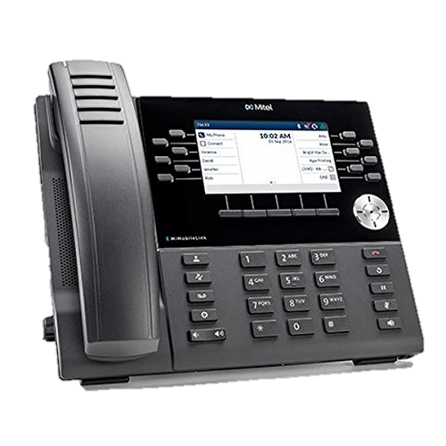
Mitel Phones
Very Slick
Cordless handset option
Favorite phone, but expensive

Slide 13
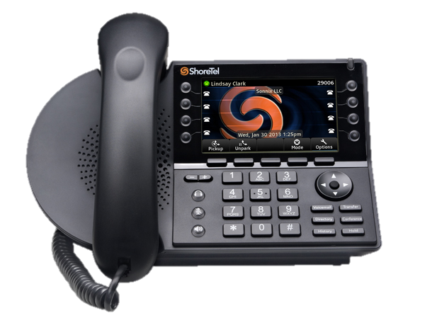
ShoreTel Phones
Big, Bulky
Loud speakerphone, but unnecessary for classrooms

Slide 14

SIP Trunk
Selected Appia for our SIP Trunk (now CallTower)
Unlimited concurrent call channels (no busy tone)
Unlimited inbound minutes
18k outbound monthly minutes (our highest month was 12k)
Any overage is a low per-minute rate (have never gone over)
50 DID numbers (Office, Admin, Operations, etc)
One time costs to setup/port numbers - $605
Monthly costs - $348
Annual Phone Cost – $4,176 (previous was $42k/year)

Slide 15

PBX
Selected 3CX for our PBX
Easy to use interface
Not open source (a benefit in our opinion)
Reasonably Priced
Runs on Windows (fits into our current environment of backups/DR)
Popular brand overseas, becoming more popular in US
Host onsite in Hyper-V (Replication, DR, Backups, etc)
Hardware requirements are low, could run small install on Raspberry-Pi
No per-extension cost. Licenses based on Simultaneous Calls. We use 64SC.
Three different levels (Standard, Professional, Enterprise). We use Pro.
Low annual license cost, EDU Discount, Pro 64SC Version about $2,500/year

Slide 16
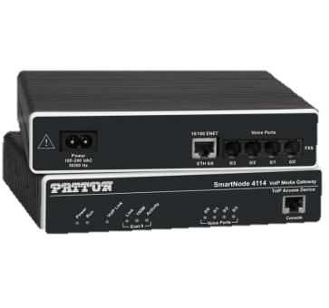
PRI/POTS
Eliminated PRI Lines
Eliminated all POTS (security, fax, elevators, Nicor, etc)
Security/Nicor – used Patton FXS Gateways
Elevators – service agreement offers LTE Device - about $45/month
Faxes – switched to eFax

Slide 17

Phones
Yealink T46S and T48S
Offered demo units before we purchased
Work great, feel sturdy
Large bright screens
Speed Dial / BLF Buttons
Physical number pad on touch screen
Conference Room – Yealink CP860
Loud speaker, optional external mics
Bright indicator lights
Easy to use

Slide 18
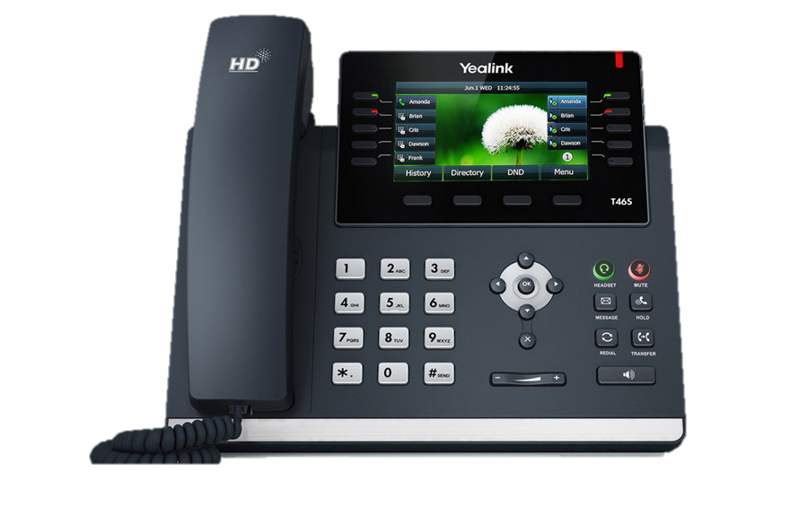
$150
All classrooms

Slide 19
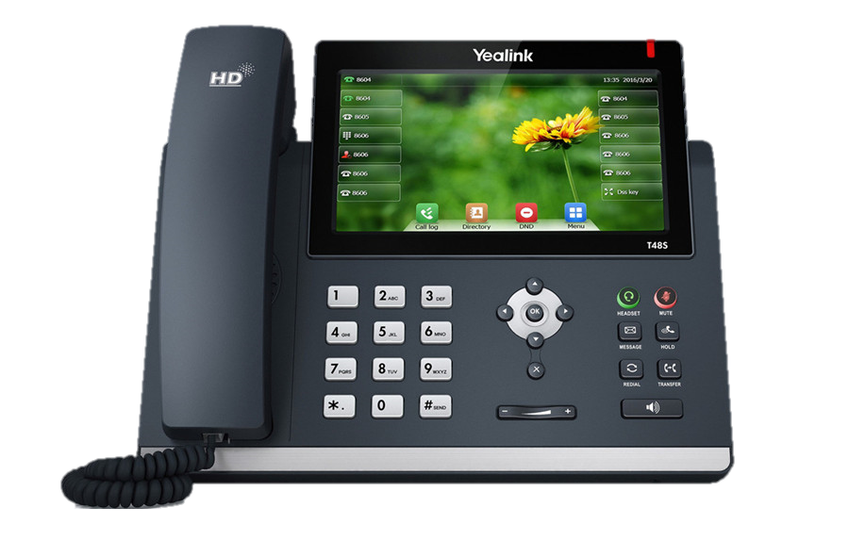
$190
All Office,
Admin, &
Technology

Slide 20
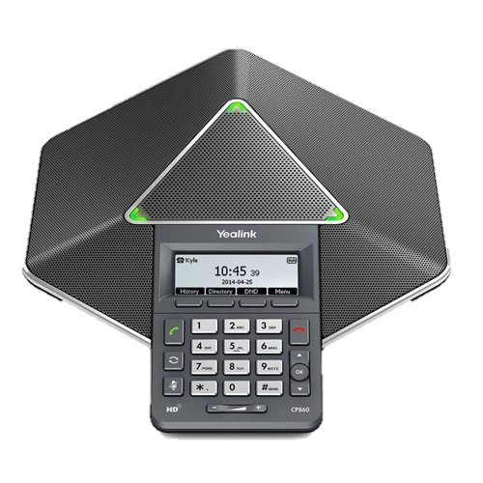
$275
Conference Rooms

Slide 21
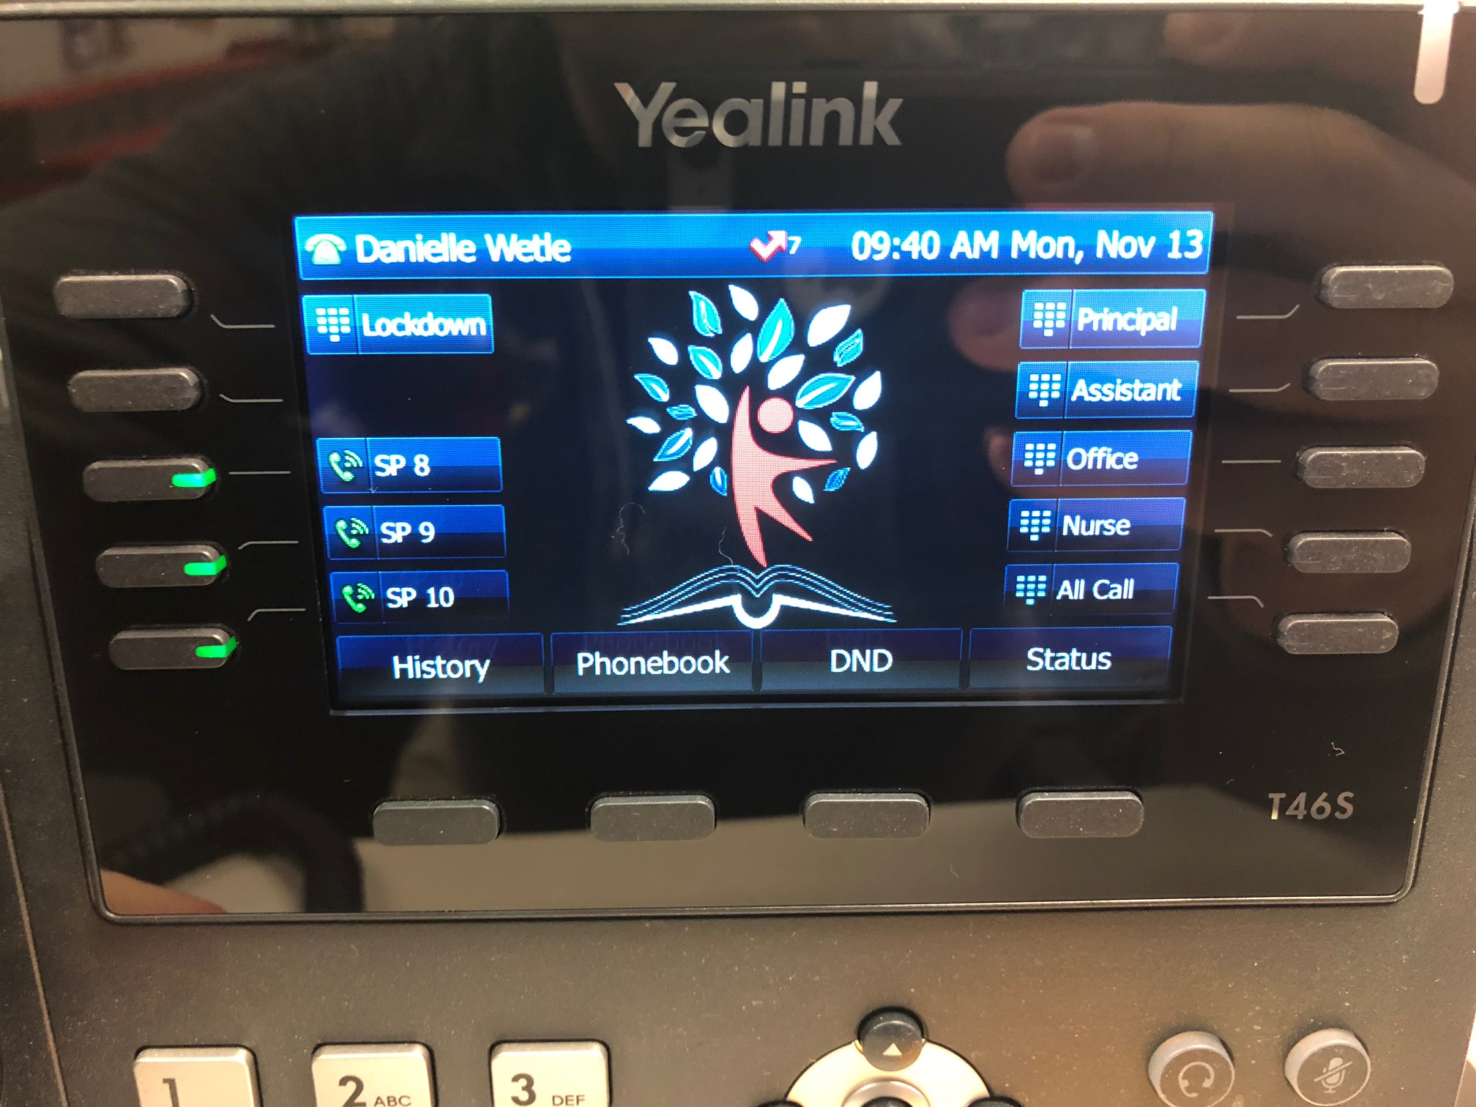

Slide 22
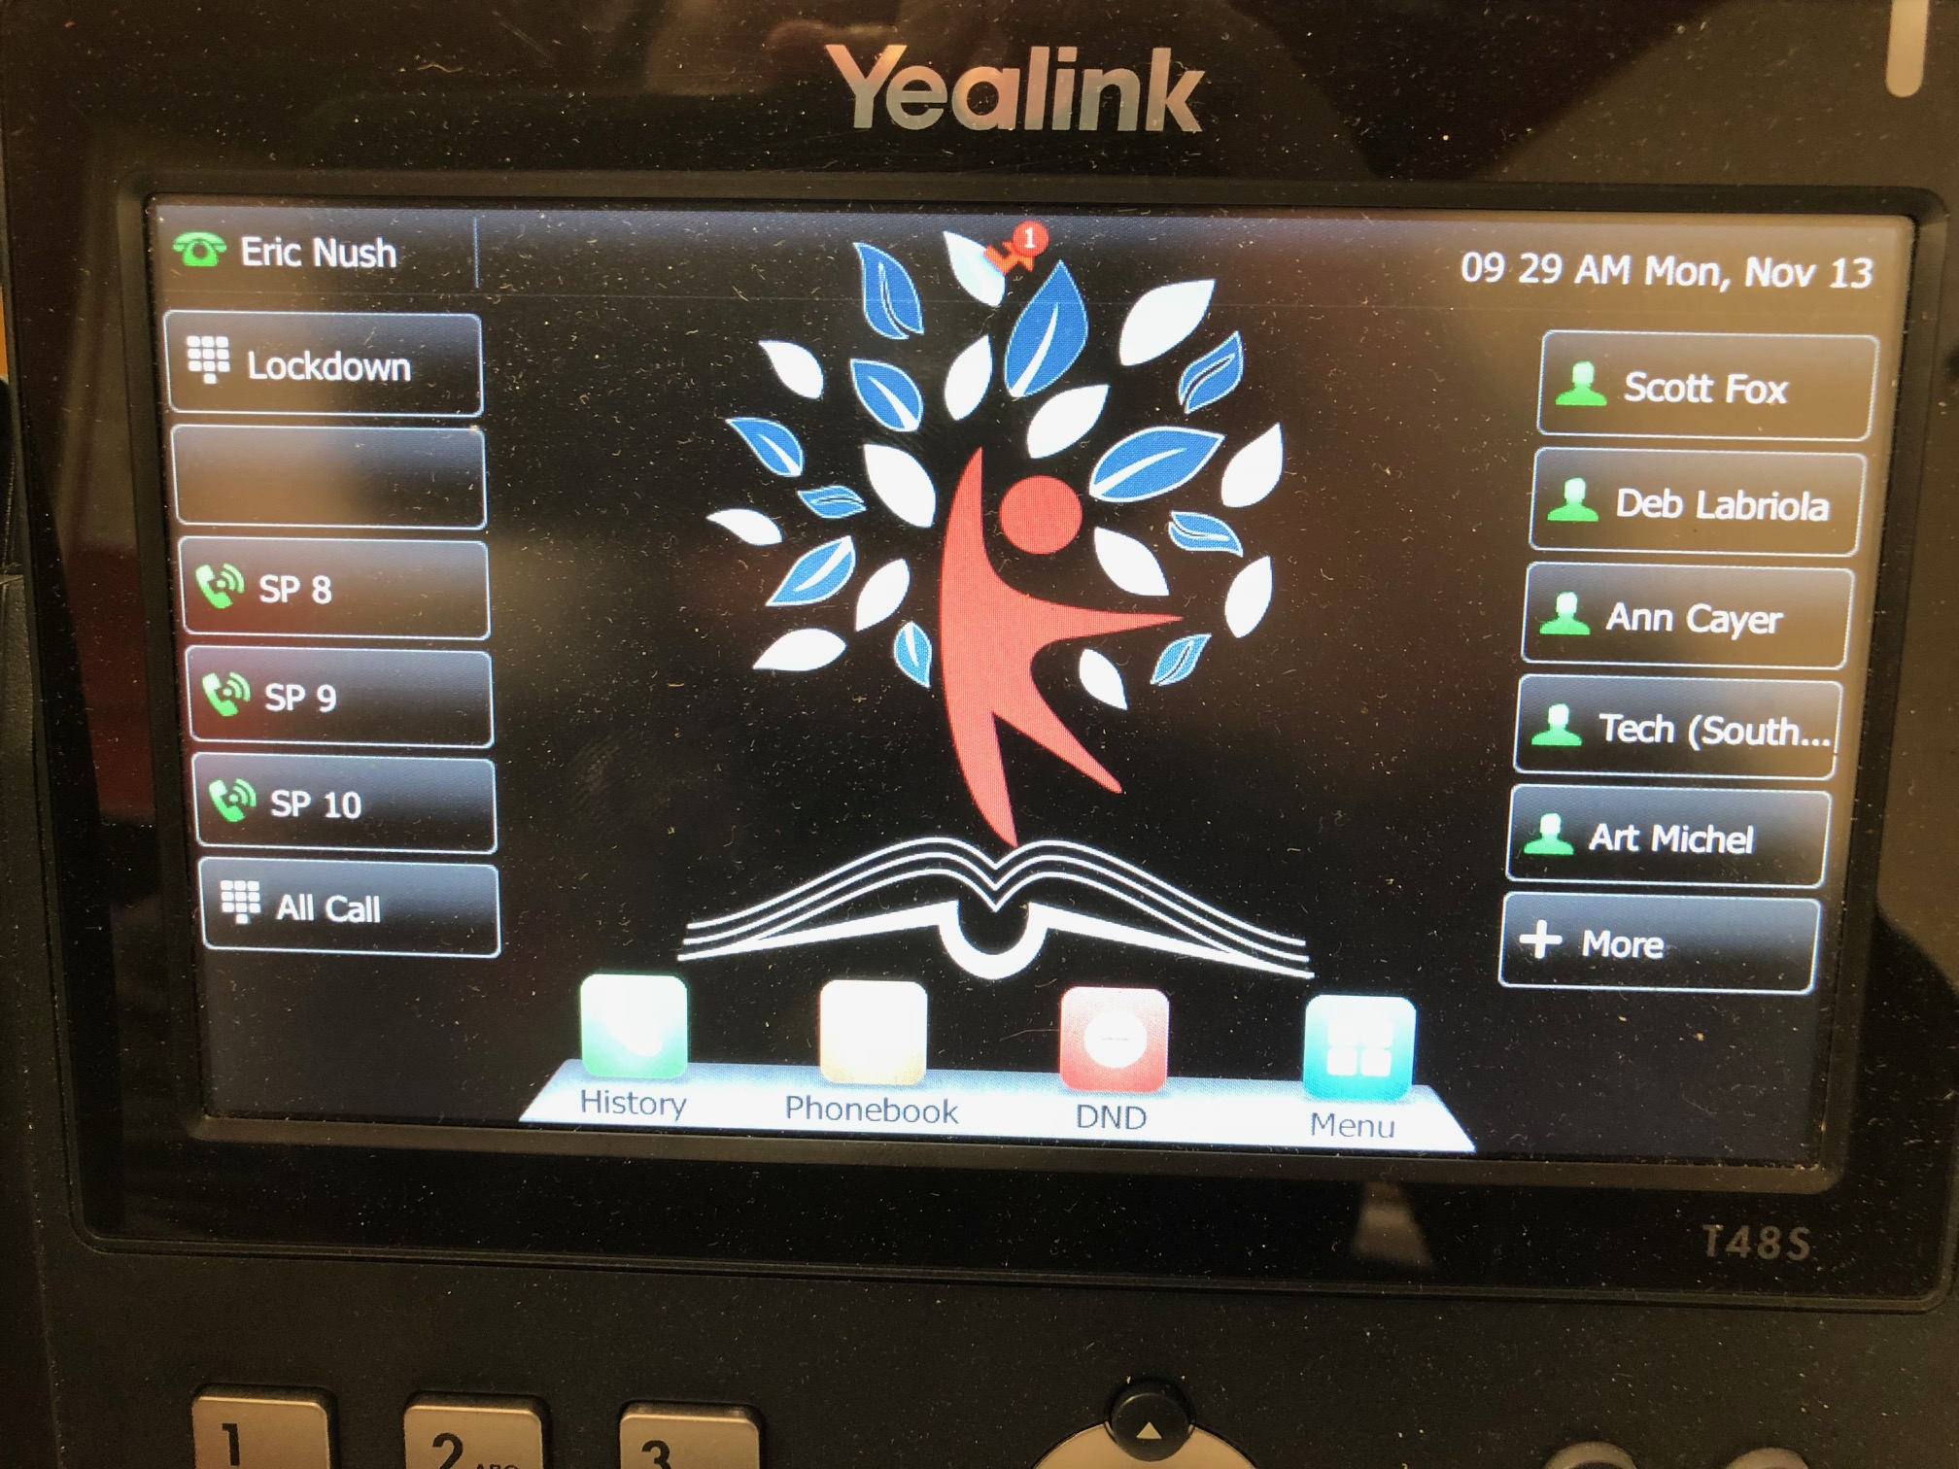

Slide 23
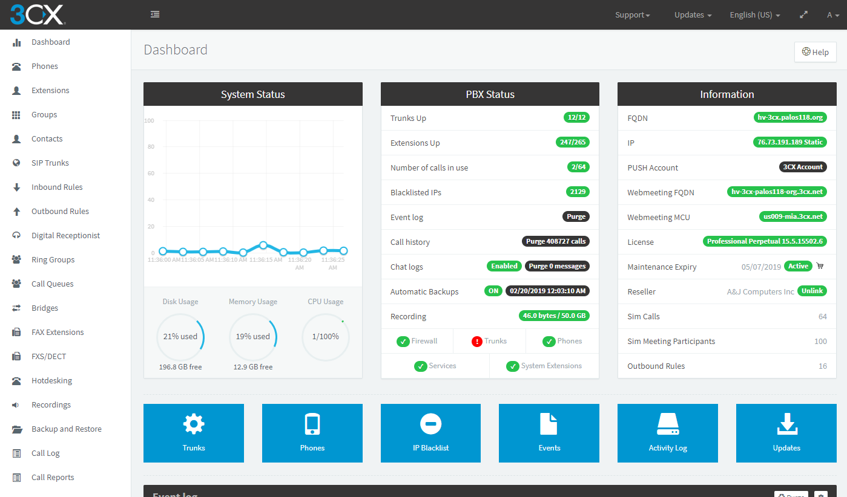

Slide 24
eFax
Replaced 10 POTS Fax lines with 6 eFax accounts
Annual costs went from $15k to $1,500
eFax Ports Numbers
Each account has 5 Emails to Send, 5 Emails to Receive
Complete Digital Trail, Secure, Compliant with HIPPA, PCI, GLBA, SOX
Incoming faxes go to common mailbox “WestFax@palos118.org”
Building secretaries monitor this inbox in Outlook
They forward or print faxes as needed, similar to taking fax off machine
Building secretaries and nurse are allowed to send
Write email to number@efaxsend.com “17087613809@efaxsend.com”
Copiers use same email account, so they can scan to fax also.

Slide 25
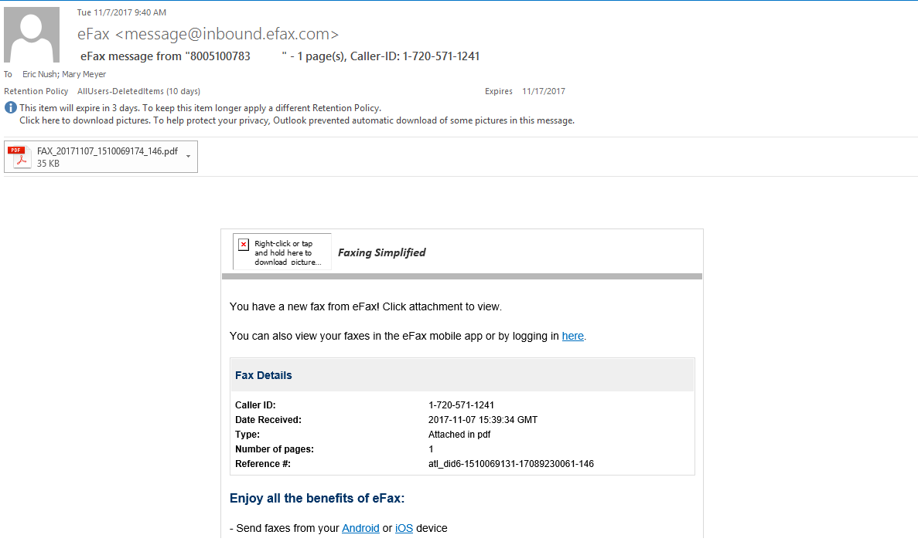

Slide 26


Slide 27


